Slide 1
Grouped GEMM in Triton
Bin Fan, Jack Kosaian, Vinod Grover | Sep 20, 2023

Slide 2
Overview
Grouped GEMM is a General mechanism for improving the utilization and performance.
Introduced in CUTLASS 2.8 and adopted by many for various use cases.
Purpose of this talk to introduce Grouped GEMM pattern to the Triton community
A PR for a new Grouped GEMM tutorial
Implemented in the existing Triton programming model
Illustrate the performance potential
Presenting the work of large number of people in the CUTLASS team

Slide 3
CUTLASS Grouped GEMM adoption
Some publicly documented use cases
Transformers at ByteDance
MoE at Microsoft
NestedTensor in PyTorch
Semented matmul in PyTorch Geometric

Slide 4
Motivation: MULTI GEMM
4 SMs, each SM can schedule 2 tiles at a time
GEMM 0
GEMM 1
GEMM 2
0
1
0
1
2
0
1
2
3
3
4
5
2
3
Tile M
4
5
Tile N
SM 0
SM 1
SM 2
SM 3
Notes:
In this example we assume that the GEMM problems are decomposed into tiles of the same size.

Slide 5
Single-Stream Execution
GEMM 0
GEMM 1
GEMM 2
0
1
0
1
2
0
1
2
3
3
4
5
2
3
Tile M
4
5
Tile N
SM 0
SM 1
SM 2
SM 3

Slide 6
Single-Stream Execution
GEMM 0
GEMM 1
GEMM 2
0
1
0
1
2
0
1
2
3
3
4
5
2
3
Tile M
4
5
Tile N
0
idle
1
idle
2
idle
3
idle
SM 0
SM 1
SM 2
SM 3

Slide 7
Background: Single-Stream Execution
GEMM 0
GEMM 1
GEMM 2
0
1
0
1
2
0
1
2
3
3
4
5
2
3
Tile M
4
5
Tile N
0
4
1
5
2
idle
3
idle
SM 0
SM 1
SM 2
SM 3

Slide 8
Single-Stream Execution
GEMM 0
GEMM 1
GEMM 2
0
1
0
1
2
0
1
2
3
3
4
5
2
3
Tile M
4
5
Tile N
0
4
1
5
2
idle
3
idle
SM 0
SM 1
SM 2
SM 3

Slide 9
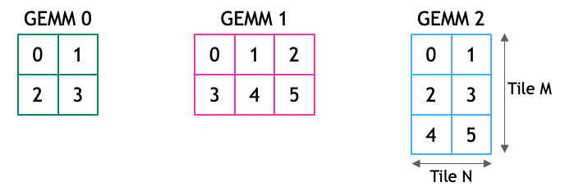

SINGLE-STREAM EXECUTION

Slide 10
Grouped GEMM
GEMM 0
GEMM 1
GEMM 2
0
1
0
1
2
0
1
2
3
3
4
5
2
3
4
5
4
5
0
1
2
3
4
5
0
1
2
3
0
1
2
3
SM 0
SM 1
SM 2
SM 3

Slide 11
Grouped GEMM
GEMM 0
GEMM 1
GEMM 2
0
1
0
1
2
0
1
2
3
3
4
5
2
3
4
5
Static Scheduler determines this assignment
4
5
0
1
2
3
4
5
0
1
2
3
0
1
2
3
SM 0
SM 1
SM 2
SM 3
TB 0
TB 1
TB 2
TB 3
TB 4
TB 5
TB 6
TB 7

Slide 12
Advantages of Grouped GEMM
Saturate GPU via multiple (potentially small) problems
Support different GEMM shapes and layouts in the same group
No need to manage multi-streaming
A single kernel launch

Slide 13
Alternatives to Grouped GEMM
Batched GEMM
Represented as a single GEMM where batch is an extra dimension and may have its own layout requirements
Multi-Streaming:
Complex launch and scheduling
Horizontal Fusion:
Require shared operands
Change of layout for operand(s) may be needed to avoid extra data movements

Slide 14
Triton Implementation
Implement a device side static scheduler
The number of virtual SMs is fixed
Visit GEMM problems in the group in order
schedule the next tile to the next available SM
when all tiles in a problem are scheduled, go to next problem until all problems are scheduled
after we use all SMs, go back to the first one

Slide 15
Triton Implementation
kernel parameters
def matmul_kernel(
a_ptr,
b_ptr,
c_ptr,
# gemm size
M, N, K,
# assuming packed layout, strides are
# represented as leading dimension
lda, ldb, ldc,
BLOCK_SIZE_M: tl.constexpr,
BLOCK_SIZE_N: tl.constexpr,
BLOCK_SIZE_K: tl.constexpr,
):
def grouped_matmul_kernel(
# pointers of all A operand in the group
group_a_ptrs,
group_b_ptrs,
group_c_ptrs,
# list of M, N, K
group_gemm_sizes,
# list of lda, ldb, ldc
group_lds,
# number of gemms in the group
group_size,
# number of virtual SMs
NUM_SM: tl.constexpr,
# tile sizes
BLOCK_SIZE_M: tl.constexpr,
BLOCK_SIZE_N: tl.constexpr,
BLOCK_SIZE_K: tl.constexpr,
):
matmul kernel signature
grouped matmul kernel signature

Slide 16
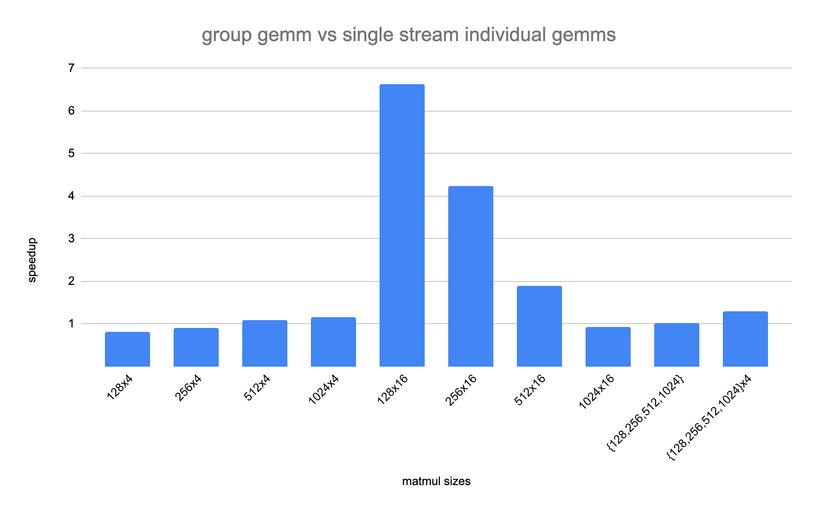
Performance on A8000
Speedup shows the grouped gemm kernel time vs the sum of individual kernel time of all gemm in the group
all inputs of matmul are square sizes, value 128 means M=N=K=128
128x4 means the group have 4 gemms
{128,256,512,1024} means the group has 4 matmuls, and for each M=N=K which equals to 128, 256, 512, 1024 respectively
{128,256,512,1024}x4 means the group has 16 matmuls, which is 4 replications of the {128,256,512,1024} group

Slide 17
Conclusion
Grouped GEMM is a flexible and general approach for multiple GEMMs
Can be implemented in the Triton Programming Model directly.
The performance results are promising
More experience needed
Contributed a tutorial example Grouped GEMM

Slide 18
Triton Implementation
tile_idx = program_id
total_tile = 0
for g in group:
m, n, k = group_gemm_sizes[g]
num_tiles = cdiv(m, tm) * cdiv(n, tn)
while(tile_idx >= total_tiles && tile_idx < total_tiles + num_tiles):
tile_idx_in_gemm = tile_idx – total_tile
# do regular gemm on tile tile_idx_in_gemm here
tile_idx += NUM_SM
total_tiles += num_tiles

Slide 19
Triton Implementation
Kernel parameters
group_a_ptrs is a pointer to device tensor
e.g. {&a0, &a1} where a0 and a1 are A operands of gemms in the group
group_gemm_sizes represents M, N, K of each gemm in the group
e.g. {{128,128,64},{64,64,32}}
group_lds is represents lda, ldb, ldc of each gemm in the group
e.g. {{64,128,128},{32,64,64}}
NUM_SM is an auto-tunable parameter
def grouped_matmul_kernel(
# pointers of all A operand in the group
group_a_ptrs,
group_b_ptrs,
group_c_ptrs,
# list of M, N, K
group_gemm_sizes,
# list of lda, ldb, ldc
group_lds,
# number of gemms in the group
group_size,
# number of virtual SMs
NUM_SM: tl.constexpr,
# tile sizes
BLOCK_SIZE_M: tl.constexpr,
BLOCK_SIZE_N: tl.constexpr,
BLOCK_SIZE_K: tl.constexpr,
):

